Slide 1

Machine Learning in Practice
Lecture 19
Carolyn Penstein Rosé
Language Technologies Institute/ Human-Computer Interaction Institute

Slide 2
Plan for the Day
Announcements
  Questions?
  Quiz
Rule and Tree Based Learning in Weka
Advanced Linear Models

Slide 3
Tree and Rule Based Learning in Weka

Slide 4
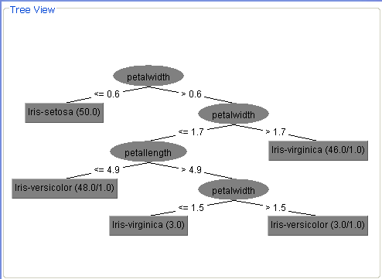
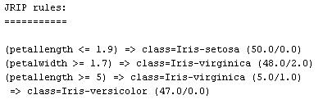
Trees vs. Rules
J48

Slide 5
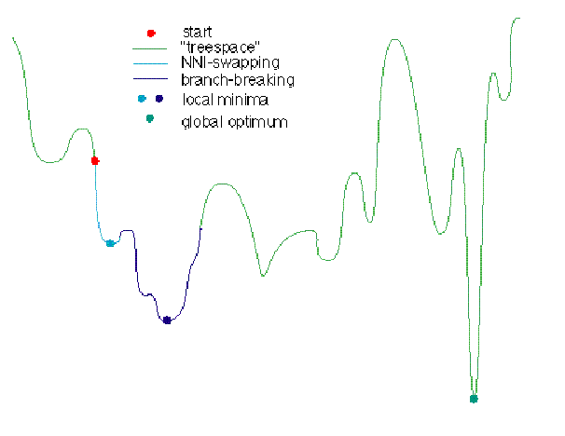
Optimization
Optimal Solution
Locally Optimal
Solution

Slide 6
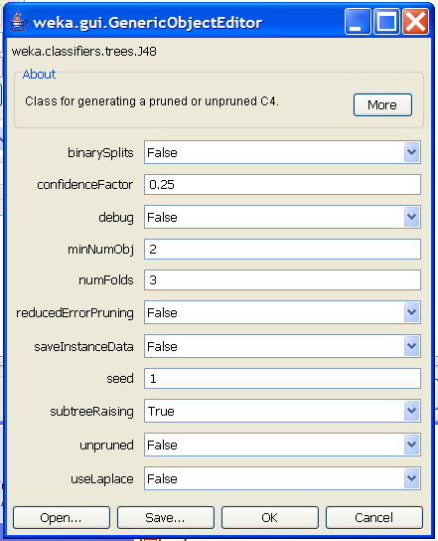
Optimizing Decision Trees (J48)
Click on More button for documentation and references to papers
binarySplits: do you allow multi-way distinctions?
confidenceFactor: smaller values lead to more pruning
minNumObj: minimum number of instances per leaf
numFolds: Determines the amount of data for reduced error pruning – one fold used for pruning, the rest for growing the tree
reducedErrorPruning: whether to use reduced error pruning or not
subtreeRaising: whether to use subtree raising during pruning
Unpruned: whether pruning takes place at all
useLaplace: whether to use Laplace smoothing at leaf nodes

Slide 7
First Choice: Binary splits or not
Click on More button for documentation and references to papers
binarySplits: do you allow multi-way distinctions?
confidenceFactor: smaller values lead to more pruning
minNumObj: minimum number of instances per leaf
numFolds: Determines the amount of data for reduced error pruning – one fold used for pruning, the rest for growing the tree
reducedErrorPruning: whether to use reduced error pruning or not
subtreeRaising: whether to use subtree raising during pruning
Unpruned: whether pruning takes place at all
useLaplace: whether to use Laplace smoothing at leaf nodes

Slide 8
Second Choice: Pruning or not
Click on More button for documentation and references to papers
binarySplits: do you allow multi-way distinctions?
confidenceFactor: smaller values lead to more pruning
minNumObj: minimum number of instances per leaf
numFolds: Determines the amount of data for reduced error pruning – one fold used for pruning, the rest for growing the tree
reducedErrorPruning: whether to use reduced error pruning or not
subtreeRaising: whether to use subtree raising during pruning
Unpruned: whether pruning takes place at all
useLaplace: whether to use Laplace smoothing at leaf nodes

Slide 9
Third Choice: If you want to prune, what kind of pruning will you do?
Click on More button for documentation and references to papers
binarySplits: do you allow multi-way distinctions?
confidenceFactor: smaller values lead to more pruning
minNumObj: minimum number of instances per leaf
numFolds: Determines the amount of data for reduced error pruning – one fold used for pruning, the rest for growing the tree
reducedErrorPruning: whether to use reduced error pruning or not
subtreeRaising: whether to use subtree raising during pruning
Unpruned: whether pruning takes place at all
useLaplace: whether to use Laplace smoothing at leaf nodes

Slide 10
Fifth Choice: How to decide where to prune?
Click on More button for documentation and references to papers
binarySplits: do you allow multi-way distinctions?
confidenceFactor: smaller values lead to more pruning
minNumObj: minimum number of instances per leaf
numFolds: Determines the amount of data for reduced error pruning – one fold used for pruning, the rest for growing the tree
reducedErrorPruning: whether to use reduced error pruning or not
subtreeRaising: whether to use subtree raising during pruning
Unpruned: whether pruning takes place at all
useLaplace: whether to use Laplace smoothing at leaf nodes

Slide 11
Sixth Choice: Smoothing or not?
Click on More button for documentation and references to papers
binarySplits: do you allow multi-way distinctions?
confidenceFactor: smaller values lead to more pruning
minNumObj: minimum number of instances per leaf
numFolds: Determines the amount of data for reduced error pruning – one fold used for pruning, the rest for growing the tree
reducedErrorPruning: whether to use reduced error pruning or not
subtreeRaising: whether to use subtree raising during pruning
Unpruned: whether pruning takes place at all
useLaplace: whether to use Laplace smoothing at leaf nodes

Slide 12
Seventh Choice: Stopping Criterion
Click on More button for documentation and references to papers
binarySplits: do you allow multi-way distinctions?
confidenceFactor: smaller values lead to more pruning
minNumObj: minimum number of instances per leaf
numFolds: Determines the amount of data for reduced error pruning – one fold used for pruning, the rest for growing the tree
reducedErrorPruning: whether to use reduced error pruning or not
subtreeRaising: whether to use subtree raising during pruning
Unpruned: whether pruning takes place at all
useLaplace: whether to use Laplace smoothing at leaf nodes
This should be increased
for noisy data sets!

Slide 13
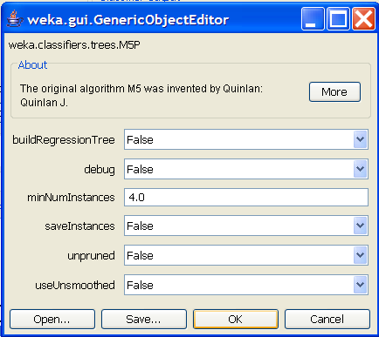
M5P: Trees for Numeric Prediction
Similar options to J48, but fewer
buildRegressionTree
  If false, build a linear regression model at each leaf node
  If true, each leaf node is a number
Other options mean the same as similar J48 options

Slide 14
RIPPER (aka JRIP)
Build (Grow and then Prune)
Optimize (For each rule R, generate two alternative rules and then pick the best out of the three)
  One alternative: grow a rule based on a different subset of the data using the same mechanism
  Add conditions to R that increase performance in new set
Loop if Necessary
Clean Up: trim off rules that increase the description length

Slide 15
Optimization
Optimal Solution
Locally Optimal
Solution

Slide 16
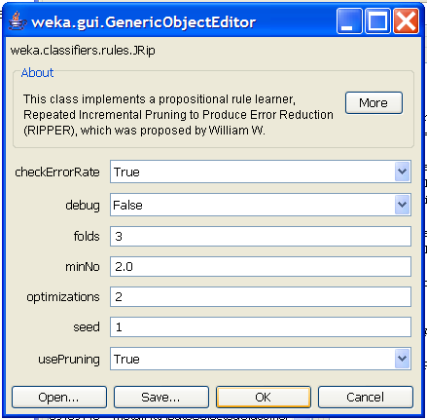
Optimizing Rule Learning Algorithms
RIPPER: Industrial strength rule learner
Folds: determines how much data is set aside for pruning
minNo: minimum total weight of the instances covered by a rule
Optimizations: how many times it runs the optimization routine
usePruning: whether to do pruning

Slide 17

Optimizing Rule Learning Algorithms
Repeated
Incremental Pruning
to Produce Error Reduction
RIPPER: Industrial strength rule learner
Folds: determines how much data is set aside for pruning
minNo: minimum total weight of the instances covered by a rule
Optimizations: how many times it runs the optimization routine
usePruning: whether to do pruning

Slide 18
Optimizing Rule Learning Algorithms
RIPPER: Industrial strength rule learner
Folds: determines how much data is set aside for pruning
minNo: minimum total weight of the instances covered by a rule
Optimizations: how many times it runs the optimization routine
usePruning: whether to do pruning

Slide 19
Advanced Linear Models

Slide 20
Why Should We Care About SVM?
The last great paradigm shift in machine learning
  Became popular in the late 90s (Vapnik, 1995; Vapnik, 1998)
  Can be said to have been invented in the late 70s (Vapnik, 1979)
Controls complexity and overfitting issues, so it works well on a wide range of practical problems
Because of this, it can handle high dimensional vector spaces, which makes feature selection less critical
Note: It’s not always the best solution, especially for problems with small vector spaces

Slide 21
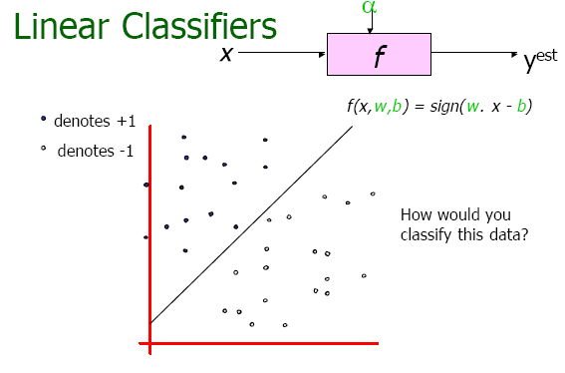

Slide 22
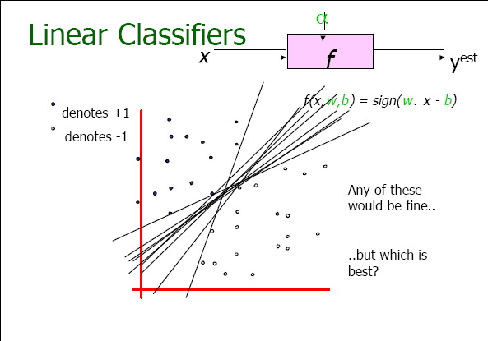

Slide 23
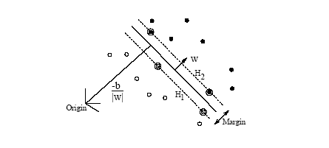
Maximum Margin Hyperplanes
* Hyperplane is just another name for a linear model.
The maximum margin hyperplane is the plane that gets the best separation
between two linearly separable sets of data points.

Slide 24
Maximum Margin Hyperplanes
Convex
Hull
The maximum margin hyperplane is computed by taking the perpendicular
bisector of shortest line that connects the two convex hulls.

Slide 25
Maximum Margin Hyperplanes
Support Vectors
Convex
Hull
The maximum margin hyperplane is computed by taking the perpendicular
bisector of shortest line that connects the two convex hulls.
Note that the maximum margin hyperplane depends only on the support vectors,
which should be relatively few in comparison with the total set of data points.

Slide 26
Multi-Class Classification
Multi-class problems solved as a system of pairwise classification problems
  Either 1-vs-1 or 1-vs-all
Let’s assume for this example that we only have access to the linear version of SVM
What important information might SVM be ignoring in the 1-vs-1 case that decision trees can pick up on?

Slide 27
How do I make a 3 way distinction with binary classifiers?

Slide 28
One versus All Classifiers will have problems here

Slide 29
One versus All Classifiers will have problems here

Slide 30
One versus All Classifiers will have problems here

Slide 31
What will happen when we combine these classifiers?

Slide 32
What would happen with 1-vs-1 classifiers?

Slide 33
What would happen with 1-vs-1 classifiers?
* Fewer errors – only 3

Slide 34
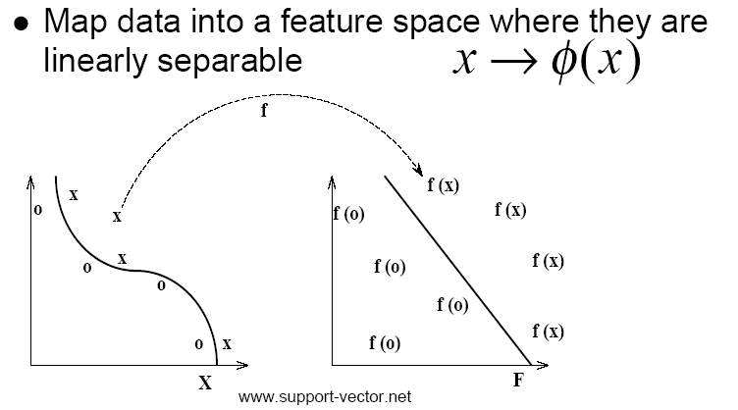
“The Kernel Trick”
If your data is not linearly separable
Note that “the kernel trick” can be applied to other algorithms, like perceptron learners,
but they will not necessarily learn the maximum margin hyperplane.

Slide 35
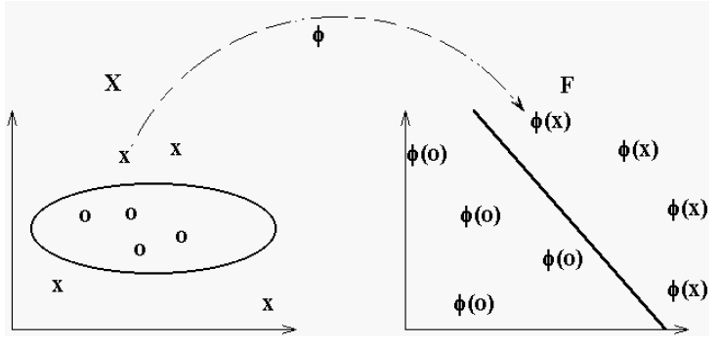
An example of a polynomial kernel function

Slide 36
What is the connection between the meta-features we have been talking about under feature space design and kernel functions?
Thought Question!

Slide 37
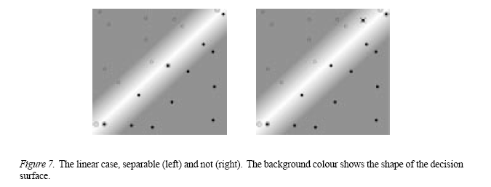
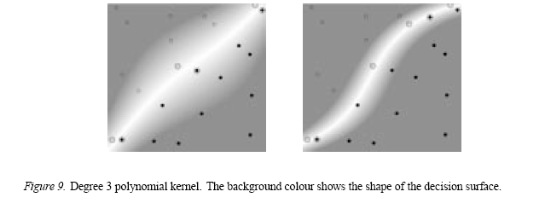
Linear vs Non-Linear SVM

Slide 38
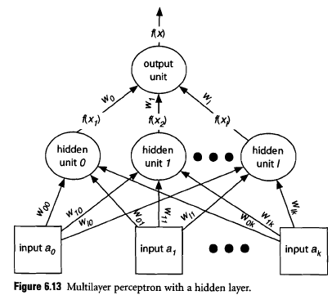
Radial Basis Kernel
Two layer perceptron
Not learning a maximum margin hyperplane
Each point in the hidden layer is a point in the new vector space
Connections between input layer and hidden layer are the mapping between the input and the new vector space

Slide 39
Radial Basis Kernel
Clustering can be used as part of the training process for the first layer
Activation on hidden layer node is the distance between the input vector and that point in the space

Slide 40
Radial Basis Kernel
Second layer learns a linear mapping between that space and the output
Second layer trained using backpropagation
Part of the beauty of the RBF version of SVM is that the two layers can be trained independently without hurting performance
That is not true in general for multi-layer perceptrons

Slide 41
What is a Voted Perceptron?
Backpropagation adjusts weights one instance at a time
Voted Perceptrons keep track of which instances have errors and do the adjustment all at once
It does this through a voting scheme where the number of votes each instance has about the adjustment is based on error distance

Slide 42
What is a Voted Perceptron?
Gets around the “forgetting” problem that backpropagation has
So voted perceptrons are like a form of SVM with an RBF kernel – so they perform similarly, but not quite as well on average across data sets as SVM with a polynomial kernel

Slide 43
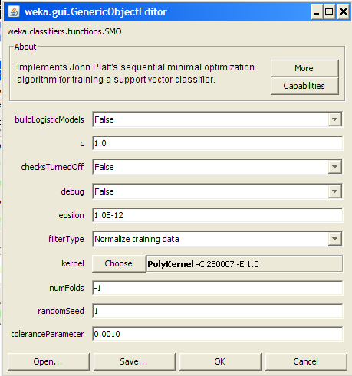
Using SVM in Weka
SMO is the implementation of SVM used in Weka
Note that all nominal attributes are converted into sets of binary attributes
You can choose either the RBF kernel or the polynomial kernel
In either case, you have the linear versus non-linear options

Slide 44
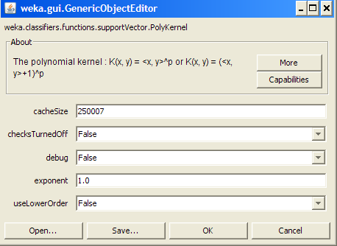
Using SVM in Weka
c is the complexity parameter C (limits the extent to which the function is allowed to overfit the data)
  “slop” parameter
Exponent: for the polynomial kernel
filterType: whether you normalize the attribute values
lowerOrderTerms: whether you allow lower order terms in the polynomial function for polynomial kernels
toleranceParameter: they say not to change it

Slide 45
Using SVM in Weka
buildLogisticModels: if this is true, then the output is proper probabilities rather than confidence scores
numFolds: cross validation for training logistic models

Slide 46
Using SVM in Weka
Gamma: gamma parameter for RBF kernels (affects how fast the algorithm converges)
useRBF: use the radial basis kernel instead of the polynomial kernel

Slide 47
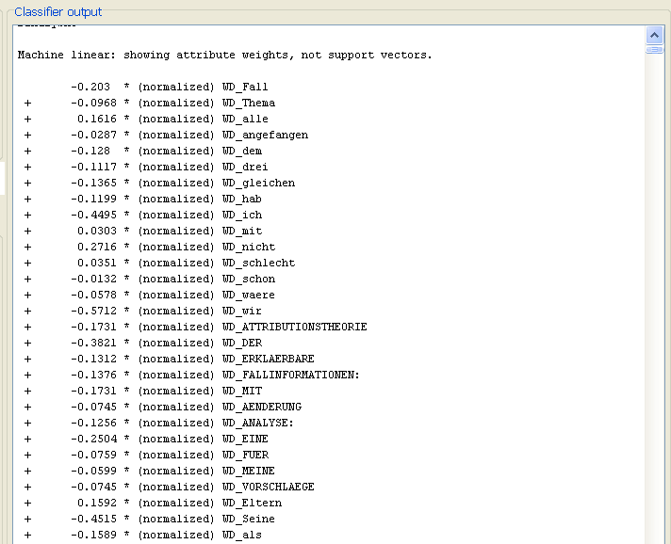
Looking at Learned Weights: Linear Case
* You can look
at which attributes
were more important
than others.

Slide 48

Note how many
support vectors.
Should be at least
as many as you have
classes. Should be
less than number of
data points.

Slide 49
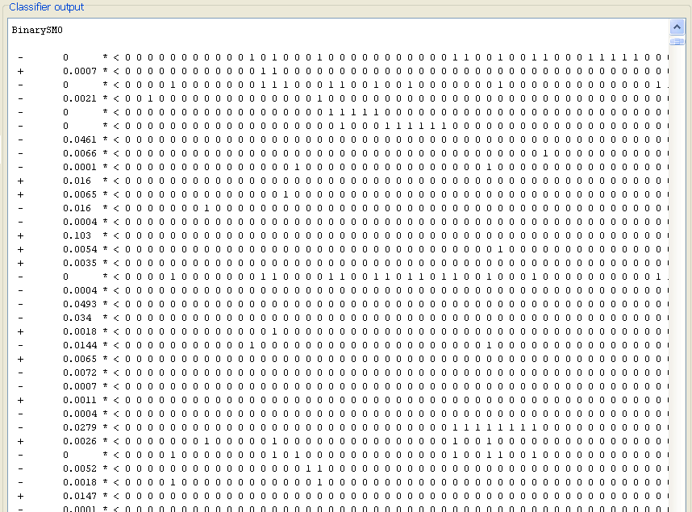
The Nonlinear Case
* Harder to interpret!

Slide 50
Support Vector Regression
Maximum margin hyperplane only applies to classification
Still searches for a function that minimizes the prediction error
Crucial difference is that all errors up to a certain specified distance E are discarded
  E defines a tube around the target hyperplane
  The algorithm searches for the flattest line such that all of the data points fit within the tube
  In general, the wider the tube, the flatter (i.e., more horizontal) the line

Slide 51
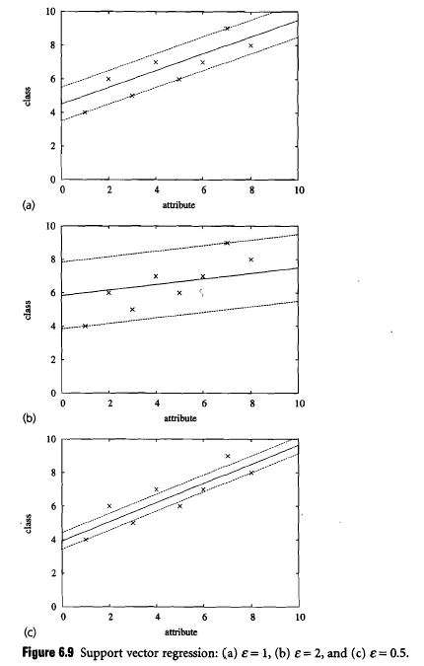
Support Vector Regression
If E is too big, a horizontal line will be learned, which is defined by the mean value of the data points
If E is 0, the algorithm will try to fit the data as closely as possible
C (complexity parameter) defines the upper limit on the coefficients, which limits the extent to which the function is allowed to fit the data

Slide 52
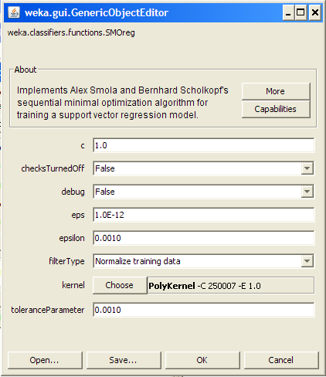
Using SVM Regression
Note that the parameters are labeled exactly the same
  But don’t forget that the algorithm is different!
  Epsilon here is the width of the tube around the function you are learning
  Eps is what epsilon was with SMO
You can sometime get away with higher order polynomial functions with regression than with classification

Slide 53
Take Home Message
Use exactly the power you need: no more and no less
J48 and JRIP are the most powerful tree and rule learners (respectively) in Weka
SMO is the Weka implementation of Support Vector Machines
The beauty of SMO and SMOreg is that they are designed to avoid overfitting
  In the case of SMO, overfitting is avoided by strategically selecting a small number of data points to train based on (i.e., support vectors)
  In the case of SMOreg, overfitting is avoided by selecting a subset of datapoints near the boundary to ignore

